Slide 1
Marketing 2022

Slide 2
Contents
1/ 3 – 6 Month Planning
Business Vertical Objectives
Brand Strategy
Channel Marketing Integrated Strategy & Tactics
Acquisition
Conversion
Retention & Reactivation
CRO - Sign Up Path & Conversion Funnel
2/ Proposed Marketing Team Structure
3/ Team Development & Goal Setting
Team Management
Performance Management
KPIs/ Data Reporting/ Analytics (+ dashboards & reporting)
4/ Building the Marketing Function to Increase Growth
Channel Marketing Flow
Integrated ASO, SEO, PR & Organic Social
CRM – Value Based Segmentation/ RFM
Bravery, Motivation & Innovation
Challenges for the New VP of Marketing

Slide 3
1/ 3 - 6 Month Planning

Slide 4
Kwalee Business Vertical Objectives
Corporate
Revenue & growth, CSR, knowledge leader in games industry, employee advocacy, training, social responsibility
Casual Games
Game development, Player CPI volume, revenue generation
Games Publishing
PC & Console Games
Game development, sales, player volume, revenue generation
Attract game devs, Support player acquisition, revenue generation
(Host Game Awards?)
Positive ROI
Positive ROI
Positive ROI

Slide 5
Brand Strategy

Slide 6
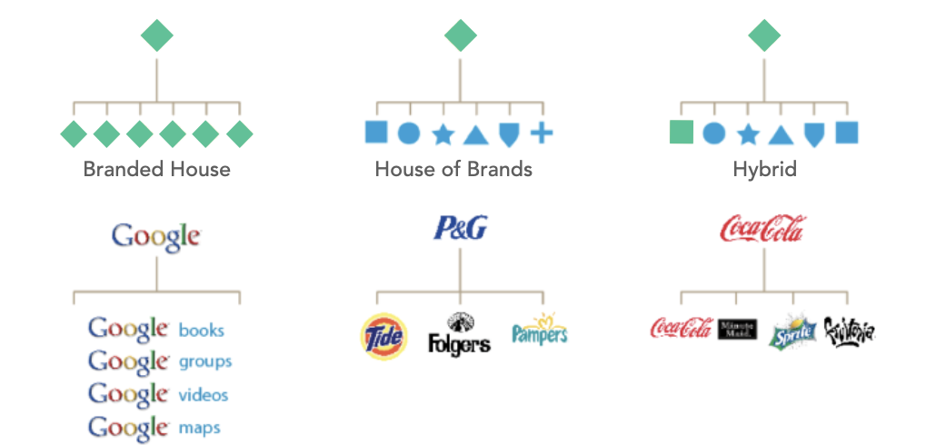
House of Brands vs Branded House

Slide 7
Brand Architecture – Kwalee’s House of Brands
Kwalee
Casual Mobile
AKA
Kwalee Mobile Games
PC & Console
AKA
Kwalee Gaming Brands
Mobile Publishing
AKA
Kwalee Games Publishing
Multiple Hyper Casual & Casual Game Sub Brands
Multiple Game Sub-Brands
Multiple 3rd Party Developer Game Brands
Draw It
Built by Kwalee
SCATHE
A Kwalee Game
JetPack Jump Powered by Kwalee
Mother Brand
Product Verticals
Sub Brand Game Segments
Distinct Sub Brands – Use tag line/ handprint identifier to tag games as Kwalee family

Slide 8
Brand Architecture Refresh
UI Testing
Localisation
Processes & Development Standards
Design Style Guidelines
Inc. Colour Swatches, Fonts, Animation, Motion Graphic, Logos & Icon/ Game Assets
Corporate & Employee Brand
UI Strategy & Customer Journeys
Merchandise
Kwalee Platform & Website
Tone of Voice
UX Strategy & Wireframes
Casual Games
Content Strategy
Publishing
Split Messaging & Comms Strategy
PC & Console
3 x Verticals
Mission, Positioning & Personality
Video/ Snippet/ Image Library

Slide 9
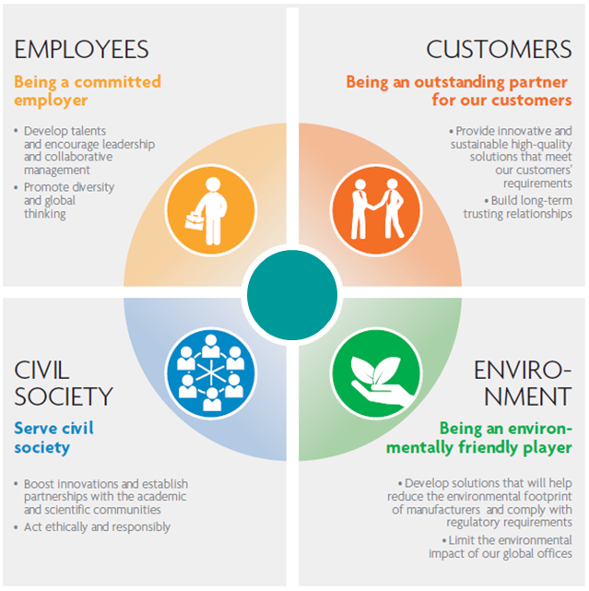
Integrity, Responsibility & Trust
A top to bottom belief and investment in player wellbeing, long term mental health, sustainability & the environment
Define what ‘good’ looks like in the casual/ mobile/ console sector – be the knowledge leader and influence other gaming businesses to follow Kwalee’s best practice
Trademarks, patents & IP – the WMS way
Treat user reviews seriously for brand and feedback reasons – App Store, Play Store, Discord, Trust Pilot, active Qual & Quant research etc
Support the industries we exist in and people we rely on – charitable/ community/ environmental commitment as a foundational CSR principal, not a ‘nice to have’

Slide 10
Channel Marketing Strategy & Tactics

Slide 11
Player Acquisition
Deliver a fully integrated brand, direct response acquisition, conversion, retention & reactivation Marcoms strategy, localised for audiences in all markets and linked to budget, KPIs and ‘challenging but achievable’ ROAS/ ROI targets
Use Cost Per Engagement KPI for paid media to increase CPA value & Real Money player ROAS
‘Test & Learn’ at heart of all creative, CTA and media campaigns. The strong survive – and thrive.
Attribution modelling & automated digi acq for onboarding/ ROI efficiency
Need to Know
Current CTA, conversion & LTV by channel/ game

Slide 12
Marketing Integration
Organic Social
Push./ SMS/ Discord/ Slack/ Twitch, WhatsApp/ In Game
Rich Content
Value Based Segmentation
Monetisation
AppsFlyer
App/ Play Store Pages
Content & Social
CRM Platform
Retention & CRM
Hubspot?
Organic Media
Own URLs – JetpackJump.com etc available
Game Web Pages
Tracking/ Reporting/ Attribution
Data/ B.I. Team
Sponsorship
SDK Networks
Paid Media
Need to Know
Metrics/ Test results by channel, CRM structure & creative asset performance
Brand & Direct
Digital Media
Paid Social
Influencers
PR
Affiliates
ASO/ SEO
PPC Programmatic

Slide 13
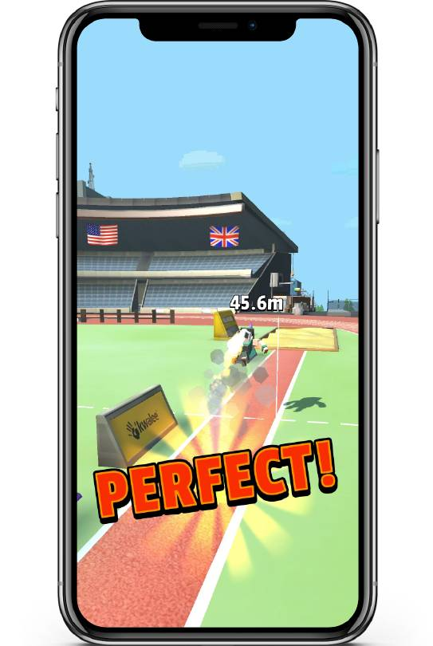
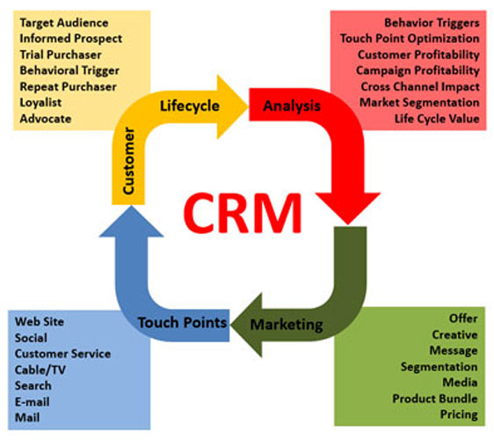
Retention & Reactivation
Onboard and integrate a CRM platform with multiple comms channel options inc. email, SMS, What’s App and in game messaging if possible – testing methodologies for capturing GDPR compliant, opted-in contacts from Apple & Google App ecosystems is the challenge here, but the prize could be extraordinary
Start to build and segment a multi cohort database to define value based segmentation, player status and need states = keep players active and spending )push notifications & targeted offers
Create a ‘Single Source of Truth’ data warehouse project to support player analysis and documentation and understand/ act on theoretical Net Gaming Revenue (NGR) and weighting = value placed on longevity/ frequency etc. in a ‘Recency/ Frequency/ Monetary (RFM) structure
The problem isn’t what to do to optimise CRM, it’s always about getting right people with right tools and getting it done – CRM belongs in every stage of the customer journey
First, we’d need to hire an excellent Head of Retention

Slide 14
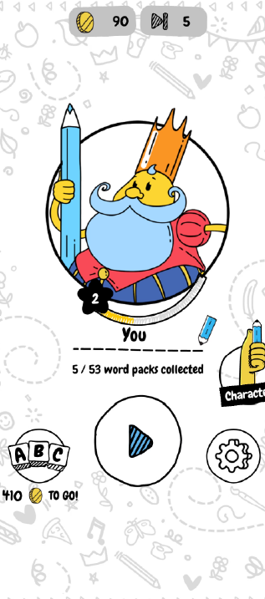
Conversion Rate Optimisation (CRO)
Every % improvement in conversion is £ saved in new player acquisition – CRO deserves our full attention
Separate early lifecycle CRO from post-deposit CRO and ensure the team is resourced to allow 1 headcount to focus on conversion in the early lifecycle
Understanding web analytics is a key part of understanding the full conversion funnel. CRO, B.I., CRM and digital marketing teams are all stakeholders, so a full picture of campaigns, first click, deposit and retention must be visible and being optimised at all times = pragmatic, near real time dashboards
Complete all necessary steps to simplify and optimise the click to deposit journey from start to finish and focus on ‘Install to First Payment’ as a core KPI
Ensure the CRO team is empowered and accountable to ensure anything that negatively effects the success of a digital campaign is tracked, prioritised and optimised in minimal time

Slide 15
Sign Up Path & Conversion Funnel
Hyper Casual Mobile
Brand, Acquisition, Rankings, ASO, K Factor
Increase Installs
Freeplay to Monetised Conversion
Increase DAU’s, WAU’s & MAU's
Retention
Engagement & Loyalty
Mitigate churn, increase APDs & LTV
Need to Know
Current sign up path/ conversion funnel & CRO metrics

Slide 16
Brand Investment
Investing in brand around game launches is a necessity, not just a ‘nice to have’ – but I don’t mean spending ££ on a TV ad… rich, sharable content
‘Mobile First’ & Apps are already where the players want to play
Fun above profit – get this balance right = loyalty, lower retention costs & higher LTVs (currently the ads on free play are REALLY intrusive, hard to exit and must push people out of games)
Becoming a loved brand that adds value, not just a short term content brand
Localisation and trans-creation of marketing, comms & games is vital
Celebrity endorsement, advocacy and influencers/ ambassadors likely to increase in importance in line with growth of social – TT & Snap are rich seams
Digital channel marketing more prohibitive = more competitive/ costly, esp in UK/ USA

Slide 17
2/ Proposed Marketing Team

Slide 18
Draft Marketing Org Structure
VP Marketing
Head of Digital Marketing
Organic Social
Head of Retention
CRM Team
Promotions & Loyalty
B.I. Insights & Analytics
Data Analytics
Head of PR & Social
Head of Marketing Creative
Product Management Team
Head of Growth
UA Team (H’Casual)
Design Team
Monetisation Manager
Monetisation & Ad Ops
Influencer Marketing
SEO & ASO
Paid Search (PPC, Paid Social, SDK)
CRO
UX/ UI
Copy
Video & Rich Content
Videographer
Motion Graphics/ Editing
Need to Know
Current performance management process

Slide 19
3/ Team Development & Goal Setting

Slide 20
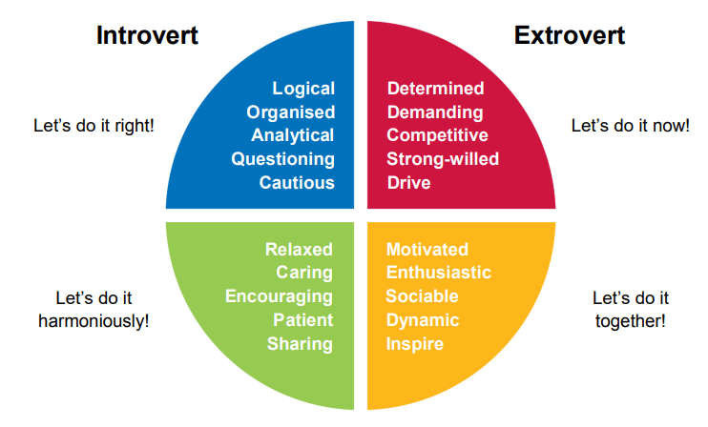
1. Strategic Focus
Data-driven, customer-centric and mirroring business objectives (plus magic of creativity)
2. Constant Communication
Effectively communicate at all levels – stakeholders, colleagues and teams
3. Enthusiastic Collaboration
Understand drivers & motivations of team members (Insights Discovery). Motivate with enthusiasm and big energy and always look to learn from and optimise with other key teams
4. Courageous Innovation
Don’t follow, lead - don’t fear change or failure and test every valid hypothesis – investing in those that meet KPI goals – I massively believe in the power of creativity to boost performance
5. Team Development
Training, coaching and mentorship to allow all members of the marketing team the best chance to exceed their potential
6. Zero Bullsh*t
Brutal honesty at all times – avoid politics, selfishness or ego at all times
7. How can I quickly adapt to ‘the Kwalee way’?
Team Management

Slide 21
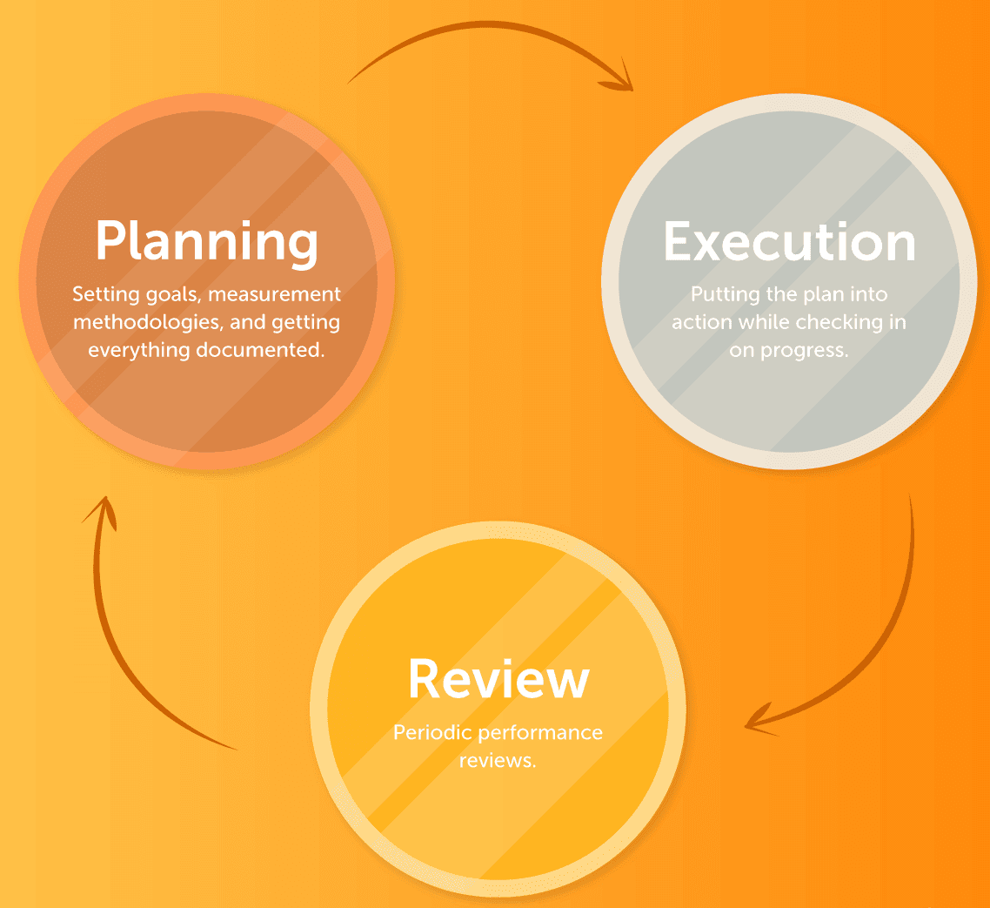
Marketing Performance Management
Collaborative planning, budgeting, performance analysis and reporting for all team members to define the scope of their role and expected OKRs
Every manager and above in the marketing team will be expected to deliver the following for their team members and channels: -
Team Purpose
Define team member roles clearly and their value to our marketing team? Update job description annually (at least)
Role Responsibilities and Priorities
What are the most important things we need to get done as a team and what do they need to contribute as individuals?
Performance Expectations
In order to keep team on track to meet its OKRs, what results does each team member need to produce? We filter these from the core marketing KPIs and link them to 1/ the budgetary spends by channel 2/ their progression plan, salary and bonus opportunity

Slide 22
KPIs/ Data Reporting/ Analytics
Gross Profit should be the bottom line marketing KPI, facilitated via:-
Game brand awareness
Increased free player volume at target Cost Per Acquisition (CPA) and Cost Per Engagement (CPE)
Net Game Revenue (NGR) daily, weekly & Monthly targets
Conversion optimisation (CRO) = % from free to £
Player retention (via CRM) = increased Active Player Days (APDs)
Average Revenue Per User (ARPU)
Lifetime Value (LTV) by game, region and acq channel
For Kwalee and game brand awareness, Brand Tracker/ Net Promoter Score (NPS) tracking can be used
Data Flow, B.I. Analysis, Insights & Reporting
Platform data integration into marketing stack is the ideal in terms of balancing players to Kwalee games on a region by region / MoM basis.
In the near term, near real time dashboard reporting is desirable to drive efficiency of spend against ROI/ ROAS
Need to Know
Current B.I. / Data function and dashboard capability

Slide 23
4/ Building Marketing Function to Increase Growth

Slide 24
Channel Marketing Flow Game Launch & Player Acquisition
Define Audience
& Markets
Define Creative,
KPIs & Budgets
Game
Mob Site
Mobile
Games Forums
Develop Store Page
& Soft Launch
Awareness
Sponsorship
3rd Party
Partners
PR
Content
Marketing
Organic
Social
K Factor
Virality
SDK
Networks
PPC
Display
Paid
Social
ASO
App Level
Bidding/ Prog
Acquisition
Test & Learn
Influencers
SEO &
Online PR
Remarketing
Freeplay
CRM
Conversion
Monetisation
Pay 2 Play
Loyalty
Retention
Promotions
Community
Need to Know
Data, creative & methodology of integrated campaign strategy to date by vertical
Repeat
Earnings/ LTV
Reactivation

Slide 25
Adding Value – Integrated Social, PR & ASO/ SEO
Social Media
Rich Videos
Benefits are shared and ROI magnified up to 3X by recycling and optimising content across multiple channels
TT, YT , Insta & Twitter Posts
Event Videos
Syndicated Articles
UGC/ Twitch
Game Case Studies
Game Feature Infographics
Employee Content
Optimised Web Content
B2C Press Releases
Promos & Comps
Game Teaser Snippets
SEO Articles & Videos
Audit & Reassign UGC & Content Outputs
On & Offline PR
Game Awards
Team News
Tech Releases
Store Pages
Online PR Link Build
ASO, SEO & Link Building
Mobile Gaming Forums
Need to Know
Current SEO & ASO strategy & metrics

Slide 26
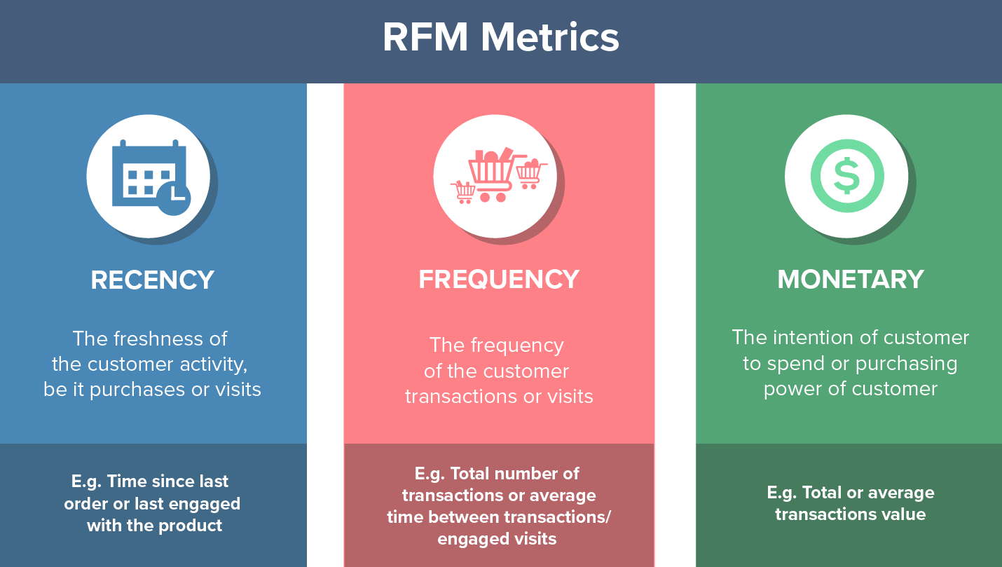
CRM – Value Based Segmentation Model
Step 1 - Determine basic segmentation criteria
Step 2 - Identify discriminating value drivers
Step 3 - Determine operational advantages/ hindrances
Step 4 - Create primary and secondary segments
Step 5 - Create segment descriptions
Step 6 - Develop segment metrics, comms actions, messages & offers by channel
Once embedded, look at RFM modelling to define true player values
 | Push Notification/ Email Message / Action
Day from Sign Up / Opt In | New/ No Open | Deposited & Played | Not Deposited? | Deposited/ Not Played
1 (Day of sign up) | 1A. Welcome message & Trageted offer
2
3 | 3A - No open? Second 2nd welcome email, new subject line & richer offer | 3B – Targeted Reload offer – added value with next deposit | 3C – Targeted Deposit Offer | 3D - Prompt email – bonus reminder
4
5 |  | 5A - Loyalty email – next deposit get xx free | 5B - Deposit offer – Spend £5 get £xx
6 | 6A - No open? 3rd email, new subject line & enhanced offer |  | 6B – Bet 10, Welcome Offer Encourage deposits and incremental play | Play prompt message
7 |  | 7A – Event email – next tournament/ current pools
8 |  | 8A - Reload offer | 8B - Deposit Offer | 8C – Play prompt email – bonus reminder
Weekly | After Day 8 players can be segmented into cohorts – new inactive unopened, new inactive, new active, new churned and then segments for higher deposit value players up to high value & VIP player segments. Players can migrate up and down between these segments depending on deposit/ bet behaviour and receive offers according to their value
Push Messaging | Pixel tracking allows for push messaging to players at each of the above stages of their lifecycle positioning and then once in cohorts can allow for segment specific Push messaging on site
Promos & Launches | Monthly & new game launch newsletters (inc video when possible) to all players plus bespoke offers to promote new game releases , competitions, features, promos and challenges

Slide 27
A Word From The Pros
“The ‘Top Free Games’ on the Games Tab are an accurate reflection of what is doing well for casual games.
You can see this with games like Subway Surfers and fill the fridge which are always in the charts.
If I was back working in games marketing, I would be utilising Tik Tok with organic, paid and influencers as my main channel :)”
Sophia George, Games Editor, App Store

Slide 28
Bravery, Motivation & Innovation
3 key drivers behind any great marketing leader, team & strategy:-
Bravery - Courage in conviction – stick with principals, treat people how we want to be treated, move swiftly and decisively to take advantage of opportunities = Drop in when the wave looks right
Motivation – Passionate leadership, clear strategy and team empowerment – encourages ‘added value’ thinking, going above & beyond and an entrepreneurial spirit
Innovation – acting like a challenger brand at all times – how do we stay hungry? How do we differentiate and innovate? What would surprise and delight our key audiences?
Never rest…

Slide 29
Challenges for the New VP of Marketing
Understand Kwalee’s business objectives and my role in getting us there
Understand Kwalee’s people/ processes and how I can adapt to fit in quickly
Formalise integrated strategy across 3 verticals / 1 month
Roll out new game launch & publishing strategy & tactics / 2 months onwards
Confirm team structure/ fill gaps, embed processes & KPIs / 3 months
Deliver approved budget in line with KPIs / 3 months
Refresh brand architecture – 3 Months
Build CRM team and onboard platform (if not Hubspot) / 3 – 6 months

Slide 30
One Last Thing…

Slide 31
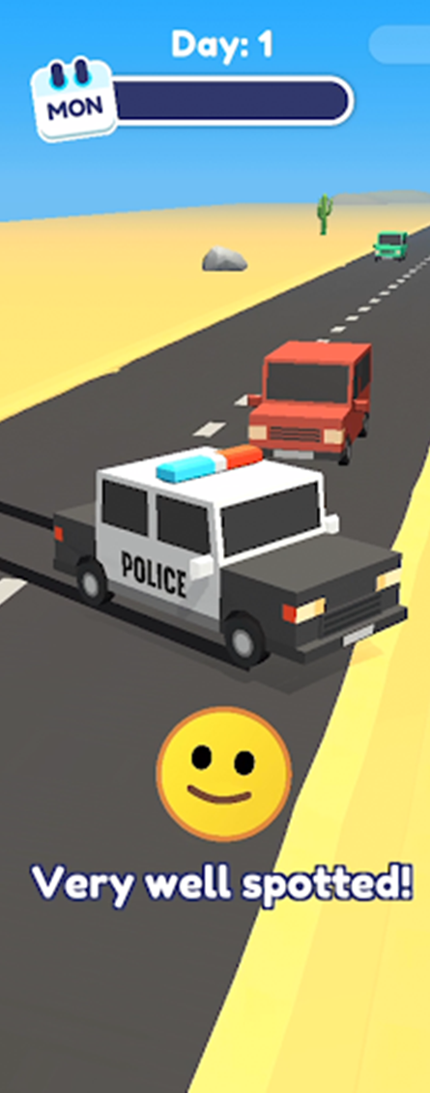
Game Web Page URLs
Organic Reach + IP Protection
Game | URLs Available (for organic reach)
Jetpack Jump | .com & .co.uk
Draw It | DrawItGame.co.uk, DrawItApp .com & .co.uk
RocketSky | .co.uk, RocketSkyGame.com
Shootout 3d | .com & .co.uk
Bake It | BakeItGame .com & .co.uk
Line Up - drawthecriminal | .com & .co.uk
Lets Be Cops | .co.uk & LetsBeCopsGame.com
Teacher Simulator | .com & .co.uk
Off The Rails | OffTheRailsGame .com & .co.uk
MakeoverStudio3D | .com & .co.uk
SneakThief3D | .com & .co.uk
Die By The Blade | .co.uk
Robobeat | .co.uk available, .com premium (£2k)
Buy Them Now!

Slide 32
Q & A

Slide 33
Appendix

Slide 34
Trends in Mobile Gaming
According to Facebook’s hyper-casual games report, the main 7 reasons why people play hyper-casual games are: -
To alleviate stress
To pass time
The feeling of accomplishment after completing a challenge
To dive into another world or character
They are impressed by something unique
To nurture something unique about them
As a connection to something they are passionate about in real life
Trends in Mobile Gaming
miHoYo’s Genshin Impact was downloaded 15 million times and earned more than $150 million in revenue in month 1 (2020).
Superior graphics, open-world gameplay, and gacha-style monetization plus the game experience is exactly the same as on PC or consoles. miHoYo managed to bring incredible single-player mechanics from AAA PC and console games to the small screens.
Subscription Gaming
More games to offer subscriptions as a monetization model, which is why this is a mobile game market trend worth mentioning.
Some examples of subscriptions in mobile games are:
Battle passes (e.g., Fortnite, PUBG Mobile)
Booster subscriptions (e.g., Boom Beach)
VIP access (e.g., Wheel of Fortune)
“Remove ads” subscription (e.g., Sand Balls)
Subscriptions are usually an additional monetization model and are most commonly used alongside
in-app purchases.

Slide 35
Trends in Mobile Gaming
Market Opportunity & Growth
According to Newzoo, there will be more than 3.07 billion mobile gamers across the globe by the end of 2023
Social Gaming Communication (Mobile Social 2.0)
Roughly two-thirds of the top 50 mobile games have at least one social feature (App Annie). Some popular social features in mobile games include:
in-game chat
social media connection
guilds
co-op modes
PvP modes
According to Facebook, “Four in ten (38%) new gamers in the U.S. said they prefer chatting with others when playing games compared to three in ten (29%) existing gamers in the U.S. who said the same.”

Slide 36
Mobile Gaming Ad Networks
Android | IOS
1. Google Ads 2. Unity Ads 3. Facebook 4. Mintegral 5. AppLovin 6. ironSource 7. MOLOCO 8. AdColony 9. Snapchat 10. Vungle 11. Chartboost 12. Digital Turbine 13. Xiaomi 14.SHAREit 15. Mistplay Among all mobile game categories, the top ten ad networks for acquiring users Unity Ads Facebook Google Ads AppLovin ironSource TikTok for Business Snapchat Mintegral Mopub Acquire Tapjoy | AppLovin Unity Ads ironSource Facebook Snapchat Mintegral TikTok for Business Google Ads Apple Search Ads Vungle

Slide 37
Mobile Gaming Forums
Mobile Gaming Forums
1. TouchArcade 2. Android Central » Android Games
3. Android Forums » Android Apps & Games
4. Reddit » Mobile Gaming
5. Tom's Guide » Mobile Gaming
6. Reddit » Android Gaming
7. HardwareZone » Handheld and Mobile Gaming
8. VGR Forum » Mobile
9. Elitepvpers » Mobile Games
10. Se7enSins » Mobile Center
11. Hard Forum » Mobile Games
dedomil.net
Neowin » Mobile Gaming
AppFutura » Mobile Game Developers Forum
The Tech Game » Mobile Gaming Forum
Something Awful » Mobile Gaming
The Tech Game » Mobile Gaming

Slide 38
Hyper Casual & Casual Game Concepts Harry Lang / August 2022

Slide 39
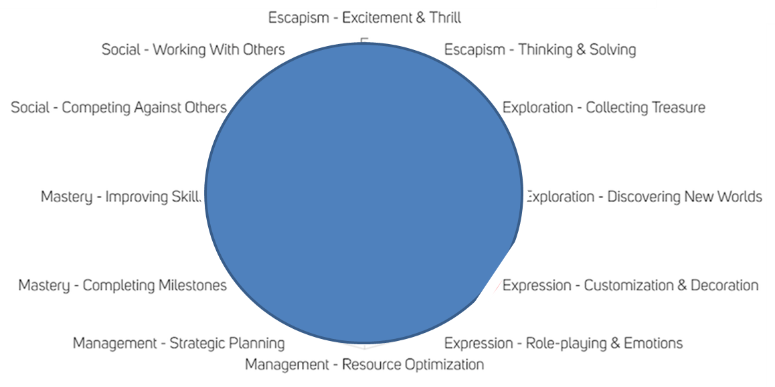
Casual & Hyper Casual Game Types

Slide 40
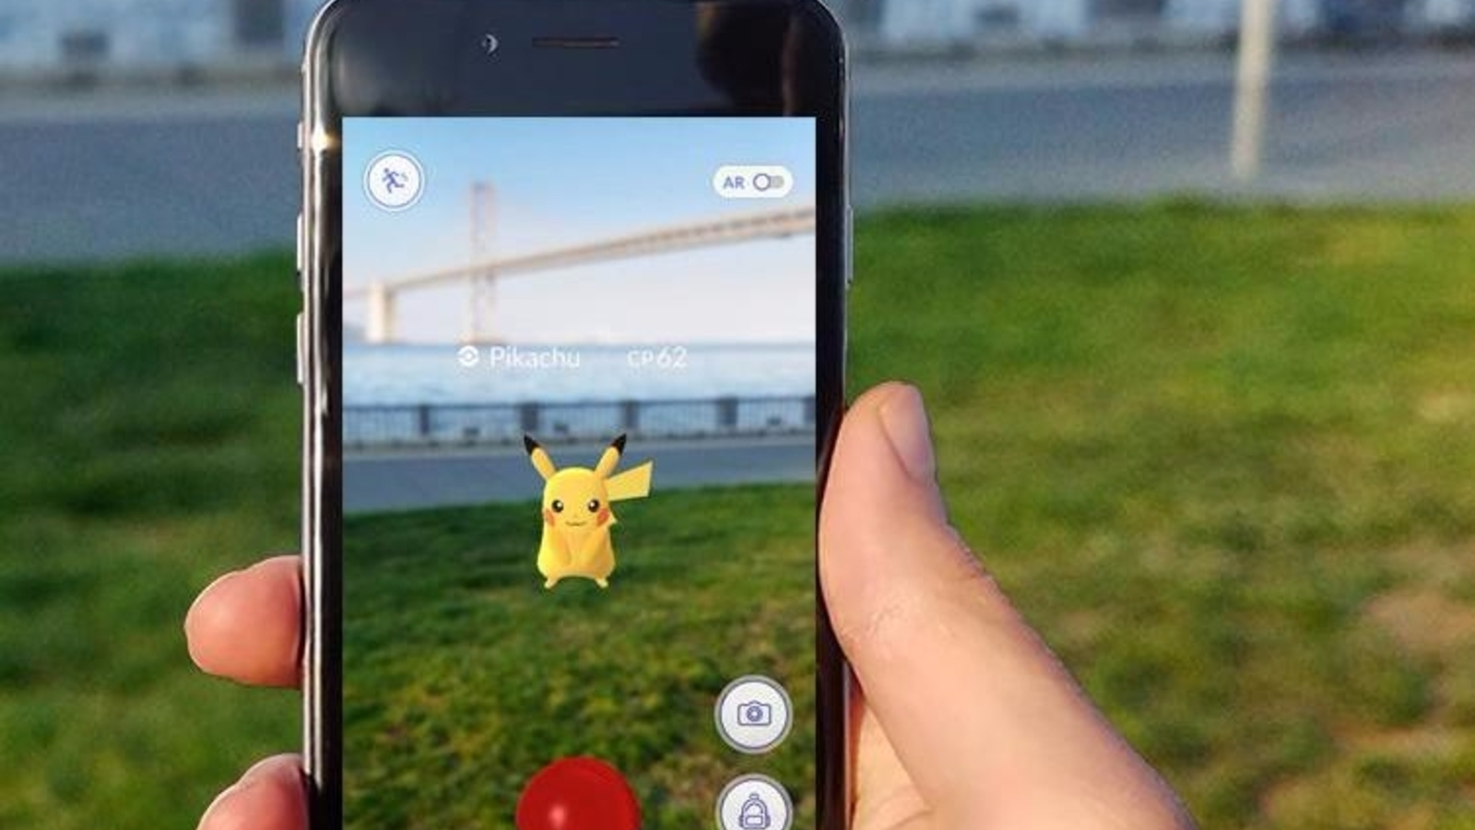
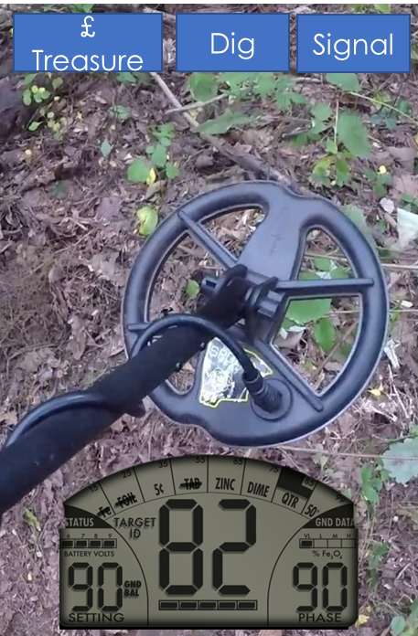
Treasure Trove A/R
Game Type
Social/ Exploration
Game Mechanic
Following the footsteps of Pokemon Go, you use your phone as a metal detector to sweep the country for treasure.
Using AR, you hunt for gold, coins and artefacts hidden at certain geodetic coordinates.
Treasure is ‘buried’ at random and is in value levels from a ring pull (1p) through to a Roman gold hoard (£10 million)
There would be one treasure spot on circa every 10m2 of each country
Compete against friends to collect one of each treasure level and win rewards/ medals/ trophies for hoarding the most total £ in treasure
Features
Collection, Hybridisation, Community Gaming
Alternate Names
Treasure Detectives, Gold Hunter
£ Treasure
Dig
Signal

Slide 41
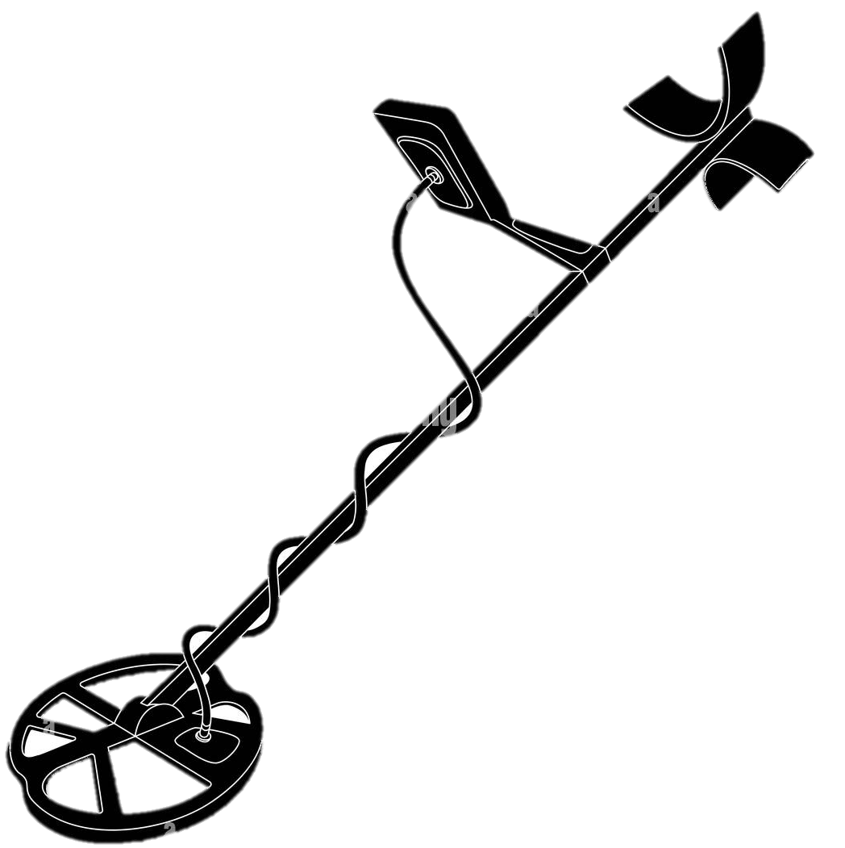
Treasure Trove
Game Type
Social/ Exploration
Game Mechanic
Use your metal detector to find hidden treasure – graduate through levels to earn more powerful detectors, bigger spades and get permission to search bigger fields/ near old settlements/ castles/ underwater. You have xx seconds to sweep your field and dig the most valuable trove. When you get to £xx value you earn upgrades/ move on levels.
Features
Collection, Hybridisation
Alternate Names
Treasure Detectives, Gold Hunter,
£ Value
Time

Slide 42
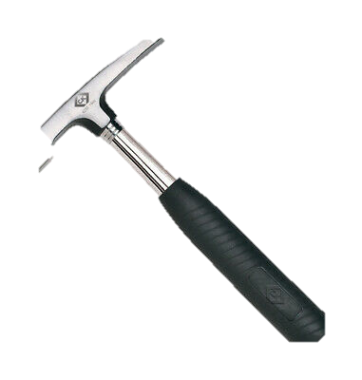
Fossil Hunter
Game Type
Social/ Exploration
Game Mechanic
Choose your path through beaches and cliffs on the Jurassic coast and Colorado savannah to find glimpses of fossils in the rocks. Collect rocks you think have fossils inside then after xx time, break your rocks with your mallet to uncover what’s inside. Score low points for ammonites/ small fish and big points for bigger dinosaur bones. You have xx seconds to sweep each beach or cliff and dig the best fossils, and you can only carry xxkg of rocks, so you’d better be sure there’s something good inside. When you get to xx points score you earn upgrades/ move on levels/ see what’s in the rocks more clearly/ move onto bigger dino fields.
Features
Collection, Guilds and Hybridisation
Alternate Names
Fossil Farm, Jurassic Bay, Findosaur
Points
Time

Slide 43
Master Caster
Game Type
Social, Mastery
Game Mechanic
Pull back, hold for power and flick screen to cast towards targets on a lake. Change angle between targets within allocated time to catch most fish. Alternate versions include Sports Fisher (off back of moving boat), Trout Teaser (Fly fishing) & Carp Catcher (over a lake)
Features
Meta Mechanics, Collection, Construction, Communities/ Guilds and Hybridisation
Rationale
Fishing is the 4th most popular participation sport in the world – 44 million Americans fish regularly
Alternate Names
Cast Away, Cast Master, Go Fish
Fish Caught
Time

Slide 44
Pole Star
Game Type
Social, Competing, Mastery
Game Mechanic –
Fierljeppen (fier—"far" and ljeppen—"leaping") or polsstokverspringen is a traditional sport of in the Dutch province of Fryslân. A jump consists of a sprint to the pole (polsstok), jumping and grabbing it, then climbing to the top of the pole while trying to control its forward and lateral movements over a body of water, and finishing by landing on a sand bed opposite to the starting point
Features
Meta Mechanics, Collection, Construction, Communities/ Guilds and Hybridisation
Rationale
Sport, competition and skill combine with a sprinkling of ‘WTF?’ to make an incrementally challenging and rewarding P2P game
Alternate Names
Far Leap, Double Dutch
Distance
Level

Slide 45
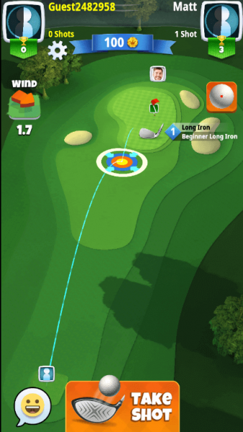
Hitting Bombs
Game Type
Social/ Mastery
Game Mechanic
A golf driving game using weapons to fire the balls. Ranging from a throw to start and moving through catapult, slingshot, trebuchet all the way through to a mortar
Features
Meta Mechanics, Communities/ Guilds and Hybridisation
Alternate Names
Long Shot, Artillery Golf, Ammo Drive

Slide 46
SkyScraper
Game Type
Social/ Mastery
Game Mechanic
A construction game in which you compete to build the tallest skyscraper possible
Levels offer you new and more robust materials and locations with firmer foundations as you travel the world building the biggest and best megastructures
Contend with freak weather and increasing materials costs as well as earning points for sustainable building
Features
Meta Mechanics, Communities/ Guilds and Hybridisation
Alternate Names
Power Tower, Sky High, Megastructure
Height
Time

Slide 47
TypeCast
Game Type
Social/ Mastery
Game Mechanic
A mobile typing challenge game – you start with a 3 letter word and move up 1 extra letter, typing as many words correctly as possible in 60 seconds. Head to head challenge with regional winners moving up leaderboard and collecting trophies
Features
Meta Mechanics, Communities/ Guilds and Hybridisation
Alternate Names
Speedwriter, Whizzwords
Letters | Word | Speed/ secs
3 | CAT | 0.4
4 | MEWS | 1.2
5 | BEST | 1.9
6 | JOUST | 2.2
7 | PUMPED | 2.8
8 | XXXXXXXX
E | _ | _ | _ | _ | _ | _

Slide 48
Pot Luck
Game Type
Social/ Mastery
Game Mechanic
A super creative and tactile escapism game challenging people to compete with their imagination and skill
Starting with your choice of clay you have 1 minute to craft a pot matching the given example on the virtual potter‘s wheel
The game decides your % match and you can win better clay, tools and more time as you progress.
A freestyle mode allows you to practice or make bespoke pots to paint and display in a gallery with votes deciding weekly winners
Features
Meta Mechanics, Communities/ Guilds and Hybridisation
Alternate Names
Potter More, Clay Maker

Slide 49
Animalphabet
Game Type
Social/ Mastery
Game Mechanic
You have the first letter of an animal’s name as a clue. A clock-shaped device reveals more of the each animal’s silhouette over 10 seconds. Guess the animal, move onto the next one. The most correct guesses wins the game points
Features
Meta Mechanics, Communities/ Guilds and Hybridisation
Alternate Names
Letter Box, Word Farm
E | _ | _ | _ | _ | _ | _

Slide 50
Current Marketing Org

